Slide 1





Digital Grave Robbing

Slide 2
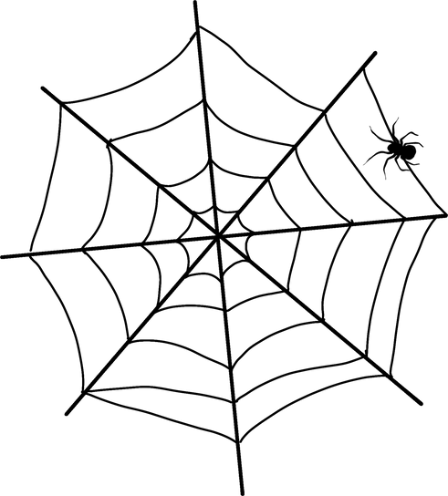
CONTEXTUAL BACKGROUND
PimEyes is a paid service that finds photos of a person from across the internet, including some the person may not want exposed. “We’re just a tool provider,” its owner said.
PimEyes has been found scraping images of the dead to populate its database. By indexing their facial features, the site’s algorithms can help those images identify living people through their ancestral connections, raising privacy and data protection concerns, as well as ethical ones.
Even after death, your data never dies!

Slide 3



STAKEHOLDERS’ GROUPS
INDIVIDUALS
PimEyes Users
Deceased People
Individuals with
digital footprint
SOCIETY
Family Members
ORGANIZATION
PimEyes

Slide 4
ETHICAL AND SOCIETAL IMPLICATIONS
Individual Issues:
Data Ownership, Data Control, Privacy and Informational Self -Determination for the deceased?
Societal Issues:
Power, Surveillance, Principles and Guidelines violated.
Organizational Issues:
Data Sourcing, Data Sharing/Disclosure, Algorithmic Decision Making,

Slide 5

ARTICLE SOURCE
A Face Recognition Site Crawled the Web for Dead People’s Photos
Published on 13-03-2023 11:00 AM
https://www.wired.co.uk/article/pimeyes-face-recognition-site-crawled-the-web-for-dead-peoples-photos

Slide 6
THANK YOU!
Lavanya Govindarajan
4230050

